Slide 1

Whatsapp Chat Analysis

Slide 2
Team-4
Mentor : Smt.G. Shanmukhi Rama
Chetan Pande 1601-20-733-027
Gokul Chinthalapudi 1601-20-733-031
Sai Kishore Bandari 1601-20-733-044
Sree Harshith Vajinepalli 1601-20-733-054
Tanish Rohil Gali 1601-20-733-056
Vishnu Sathwik Rebally 1601-20-733-060

Slide 3
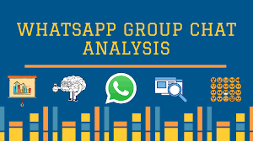
About the project
Whatsapp Chat Analysis
WhatsApp is used by millions of users to express emotions and share feelings. The model is presented in this paper aims to perform sentimental and emotional analysis using textual messages and emojis used in WhatsApp chats.
The composition of the emotions expressed by the subject (out of Happy, Sad, Bored, Fear, Anger and Excitement) are defined. The scores are added up for each subject. Throughout the analysis, the behavioral traits are extracted.

Slide 4
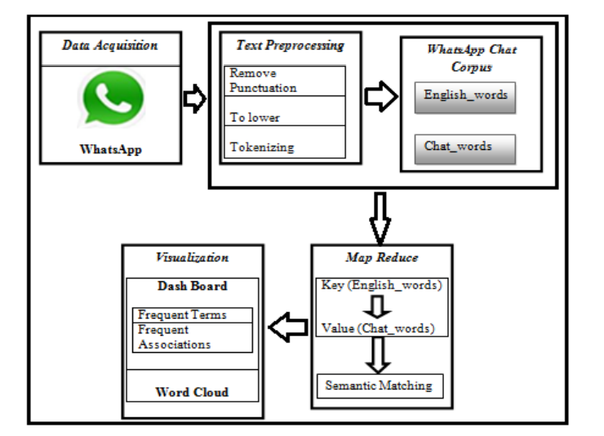
Work Flow Of Whatsapp Chat Analysis
Figure 1: Framework and Methodology for WhatsApp Chat Transliteration

Slide 5
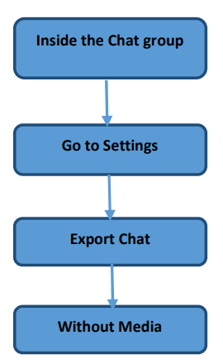
Text Pre-Processing:
Preprocessing:
a) Removing Punctuation: WhatsApp message contains punctuation marks. So they are removed to reduce the memory space.
b) Converting to lowercase: WhatsApp users use variety of text typed in upper case, lower case and toggle case, which varies for every user. So they are converted into lower case to normalize in a common form.
c) Tokenization: The WhatsApp data is tokenized and split into individual chat words
Data Acquisition:

Slide 6
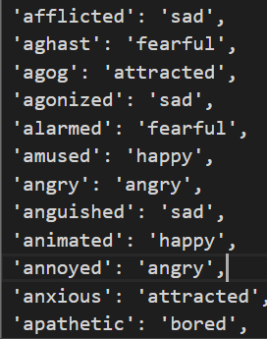
Creation of WhatsApp Chat Corpus Model :
The WhatsApp chat corpus is created by mapping the original key values with different values.
Semantic MapReduce Framework for WhatsApp Data:
The corpus Eng_wrd and Chat_word consists of many objects. In Eng_wrd collection it has the key pair and in Chat_word collection it consists of value pairs. The key and value pairs are mapped using MapReduce task. The mapper function map serves as an input to the reducer function.The reducer function unites all the value pairs with the key pair and then it create sorted list. It typically compresses the list of values to creator the shorter list.

Slide 7
Technologies used:
Modules Used:
NLTK
SentiWordNet
Seaborn
Matplotlib
Pandas
Numpy
Regex
Flask
HTML
Jupyter Notebook
Bootstrap

Slide 8
Implementation

Slide 9
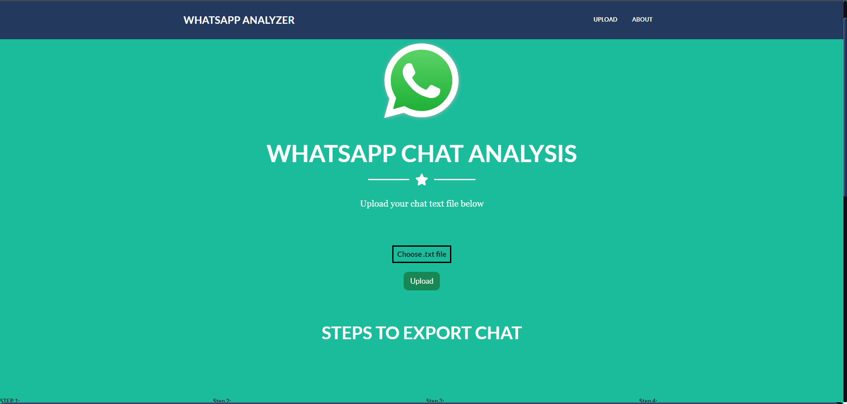
Before File Upload :

Slide 10
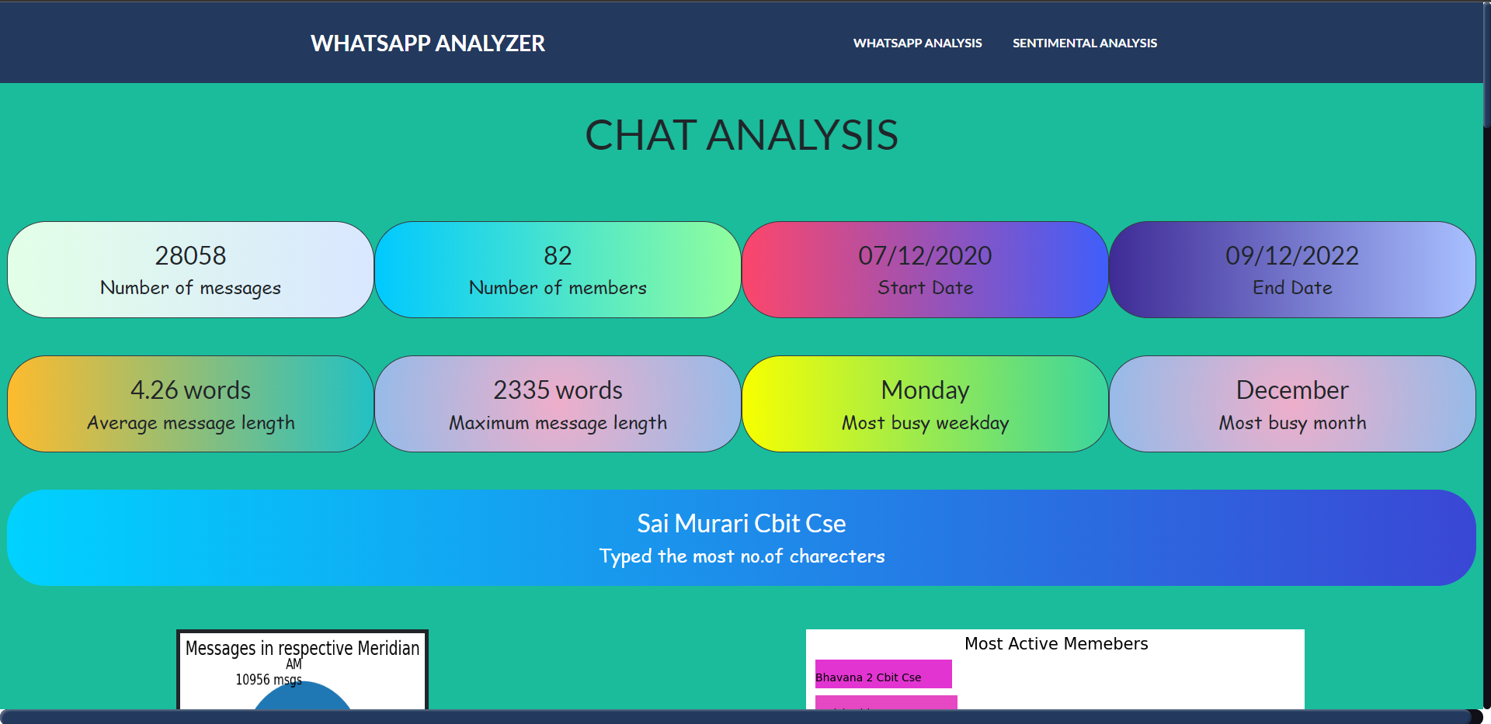
After File Upload:

Slide 11
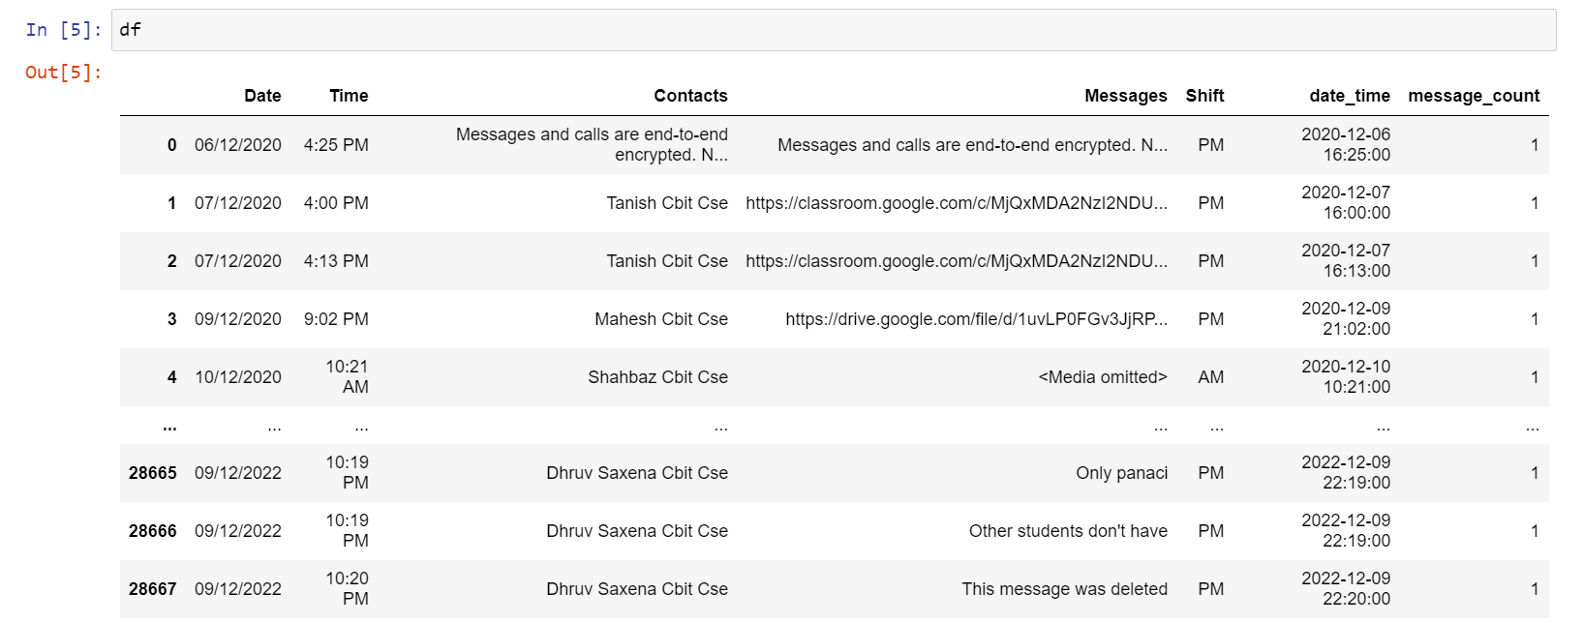
Parsed DataFrame

Slide 12
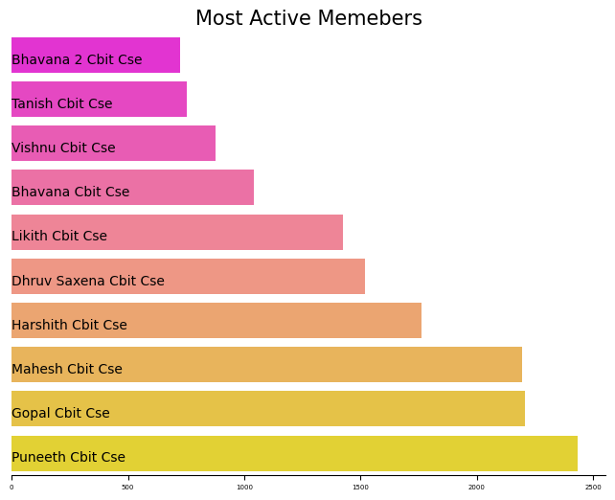
Exploratory Data Analysis
Most Active Members:
This plot is used to represent the top 10 most active users of a whatsapp chat

Slide 13
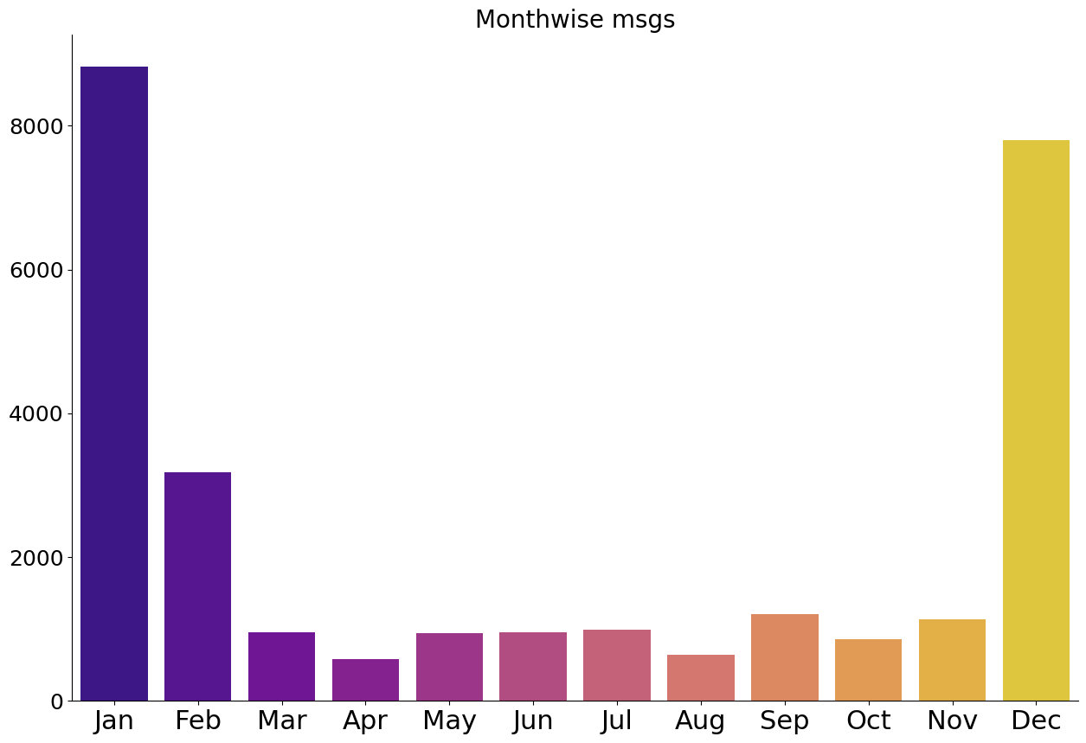
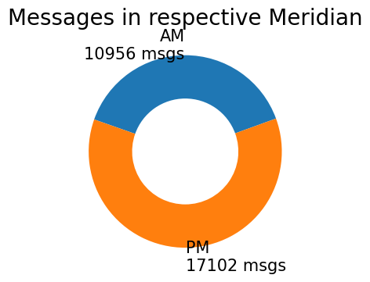
Month Wise messages:
This is a bar plot representing the no of messages in each month
Messages in respective meridians:
This plot is used to represent the no of messages in AM and PM

Slide 14
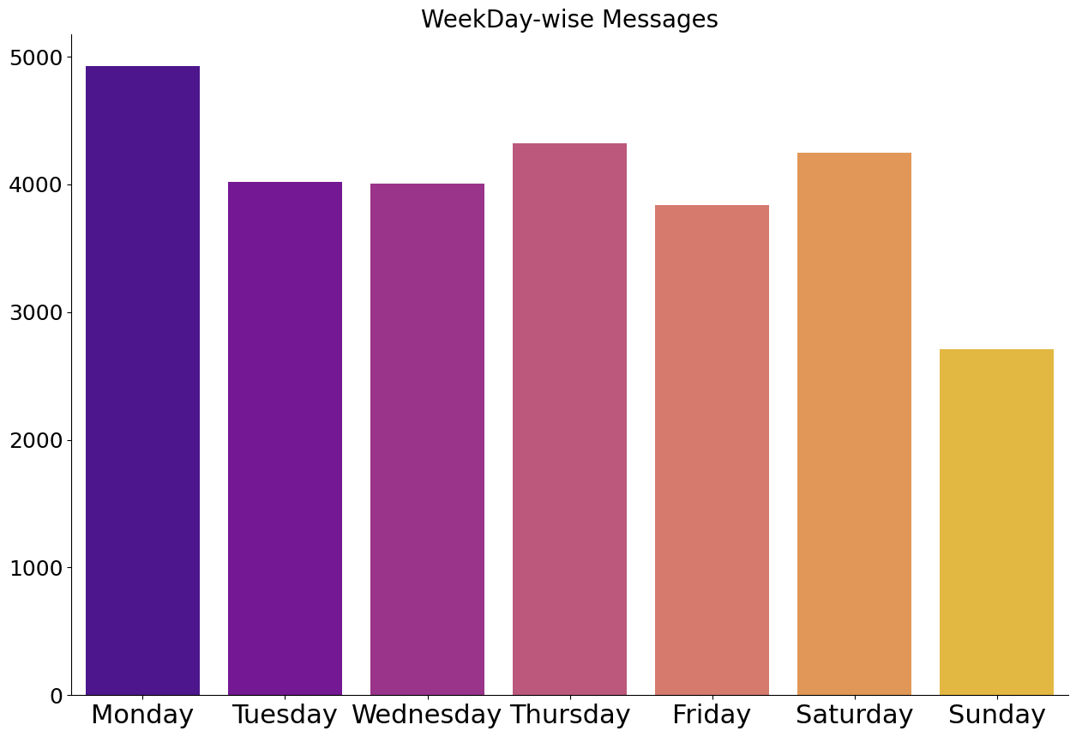
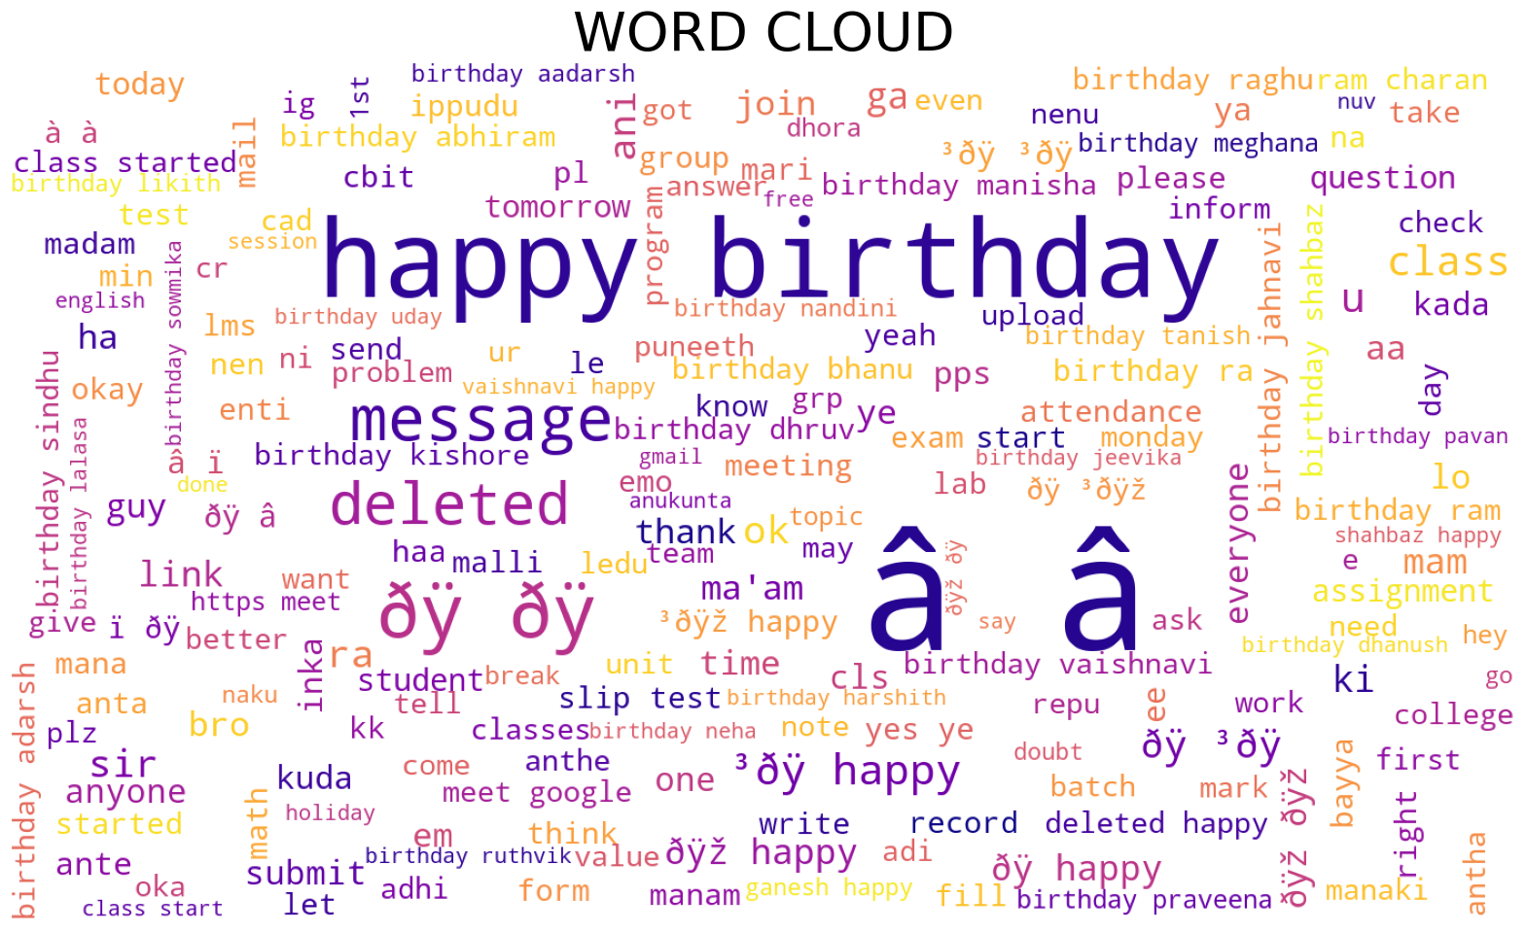
Week Day-wise Messages:
This is a bar plot representing the no of messages in each day of a week
Word Cloud:
This is a pictorial representation of a text, in which the words appear bigger the more often they are mentioned.

Slide 15
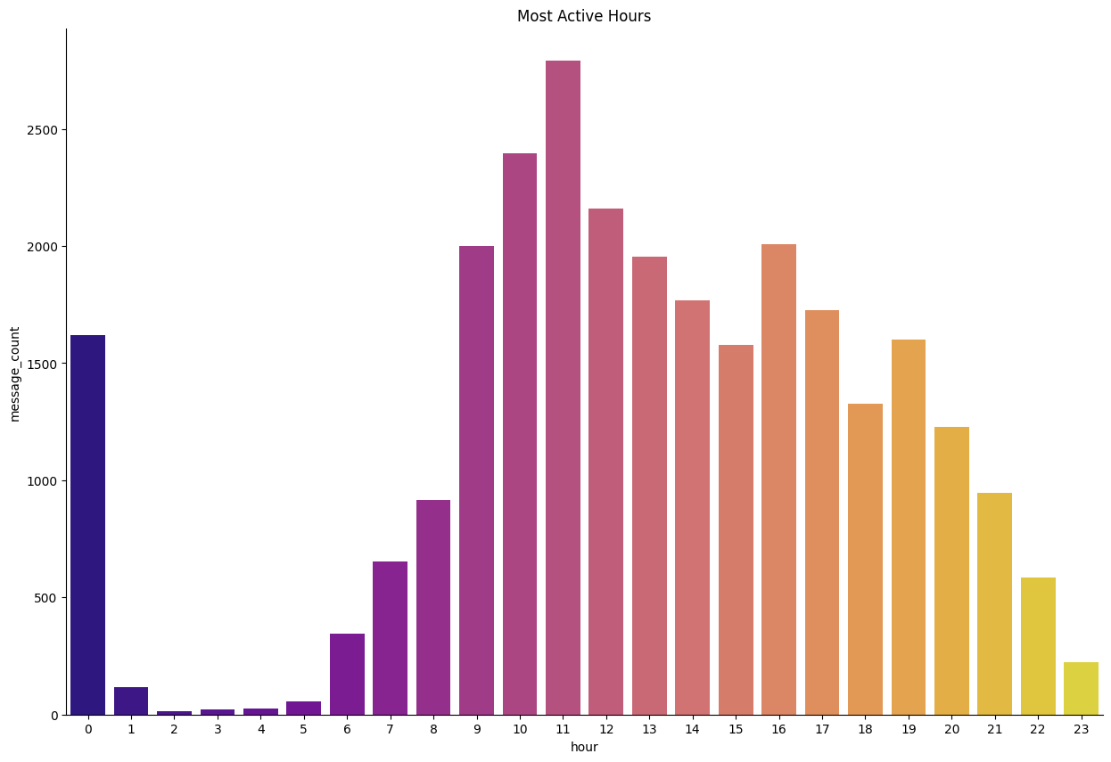
Most Active Hours:
This is a bar plot representing the no of messages in each hour of a day

Slide 16
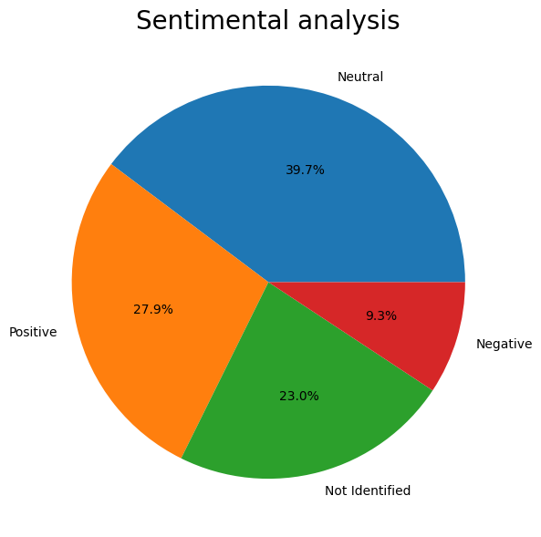
Sentimental analysis
This pie chart is used to describe the sentiment scores of our data

Slide 17
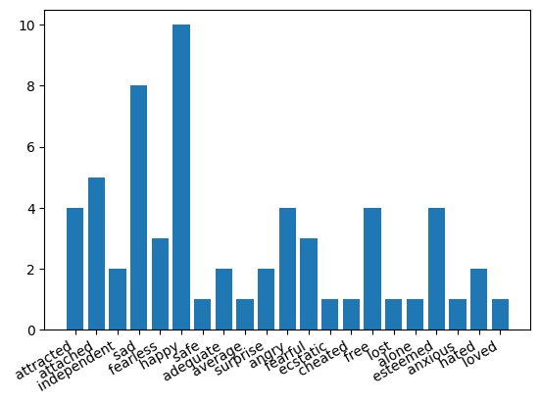
Emotion analysis using bar plot
To analyze the sentiments and emotions of students in several ways such as anger,surprise and dominance space by classifying the messages from their WhatsApp group chat.

Slide 18
Thank You

